Slide 1
Using HLS IP in Zynq SoC Design
310551050 陳聖文

Slide 2
Contents
What you will learn
Vitis HLS IP Design
Design Code
Build Block Design through Vivado (Lab1,2)
ARM C code
Lab1 – MAC with AXI4-Lite
Lab2 – Real FFT with AXI4-Stream
Program FPGA and build C program through Vitis IDE

Slide 3
What you will learn
How to create Vitis HLS IP using a Tcl script
How to import an HLS design as IP into IP integrator
How to connect HLS IP to a Zynq SoC using AXI4-Lite interfaces and AXI4-Stream interfaces
How to configure HLS IP with AXI-Lite in software
How to control DMAs using AXI4-Stream in software

Slide 4
Contents
What you will learn
Vitis HLS IP Design
Design Code
Build Block Design through Vivado (Lab1,2)
ARM C code
Lab1 – MAC with AXI4-Lite
Lab2 – Real FFT with AXI4-Stream
Program FPGA and build C program through Vitis IDE

Slide 5
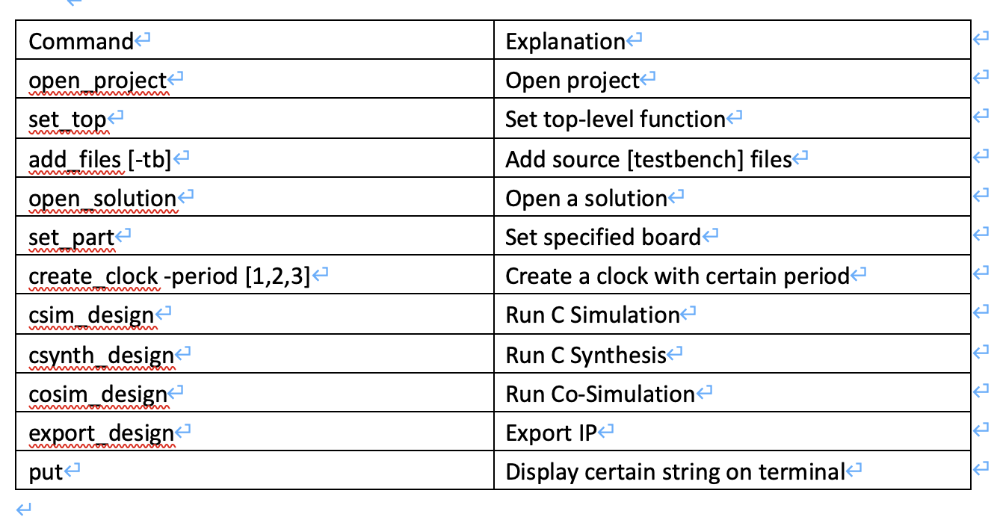
SCRIPT
vitis_hls –f run_hls.tcl

Slide 6
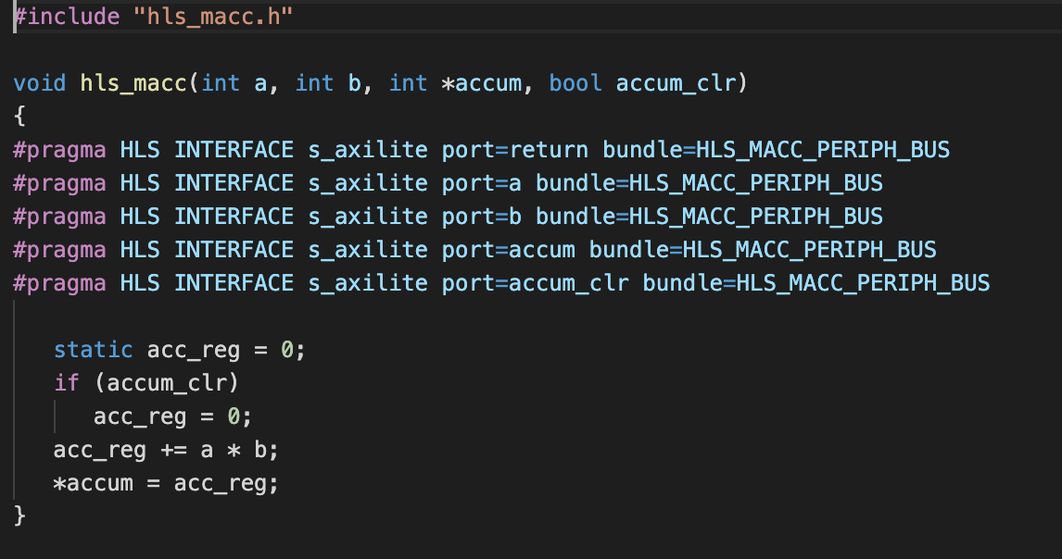
Design Code
Lab1 – MAC with AXI4-Lite

Slide 7
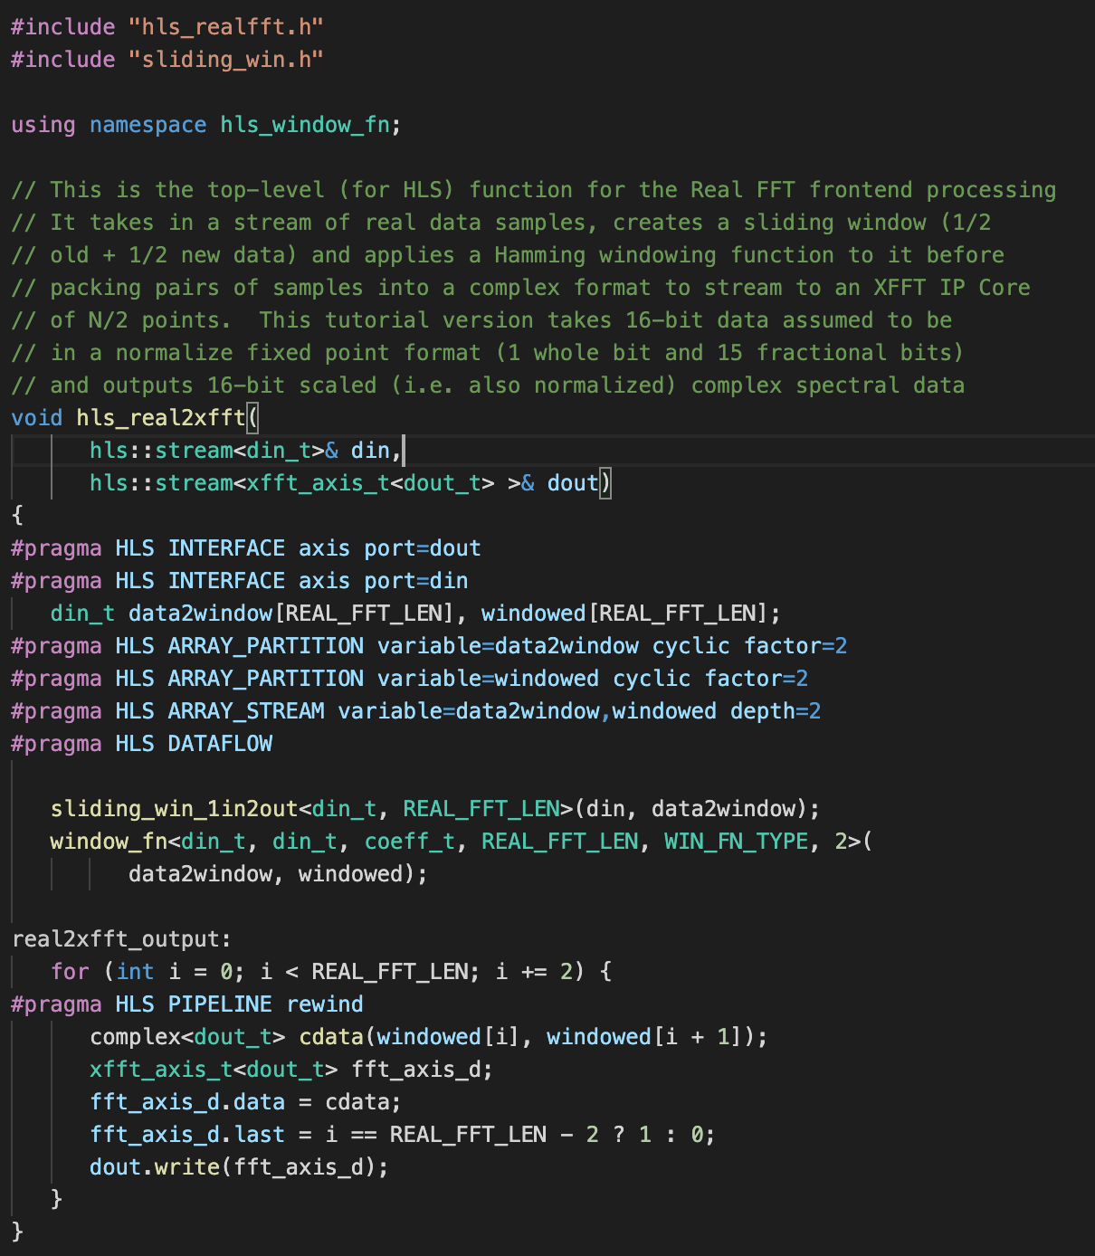
DESIGN CODE
Lab2 – Real FFT with AXI4-Stream
hls_real2xfft()
hls_xfft2real()
Pipeline

Slide 8
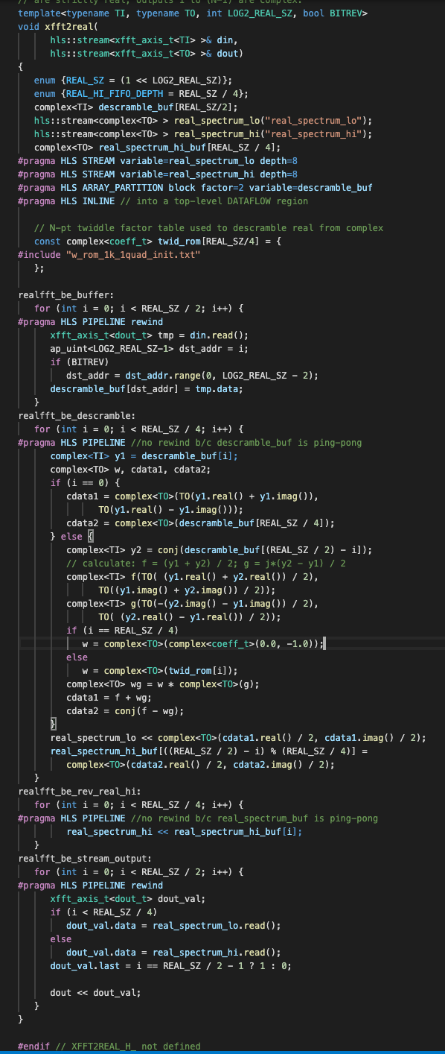
DESIGN CODE
Lab2 – Real FFT with AXI4-Stream
hls_real2xfft()
hls_xfft2real()

Slide 9
Contents
What you will learn
Vitis HLS IP Design
Design Code
Build Block Design through Vivado (Lab1,2)
ARM C code
Lab1 – MAC with AXI4-Lite
Lab2 – Real FFT with AXI4-Stream
Program FPGA and build C program through Vitis IDE

Slide 10
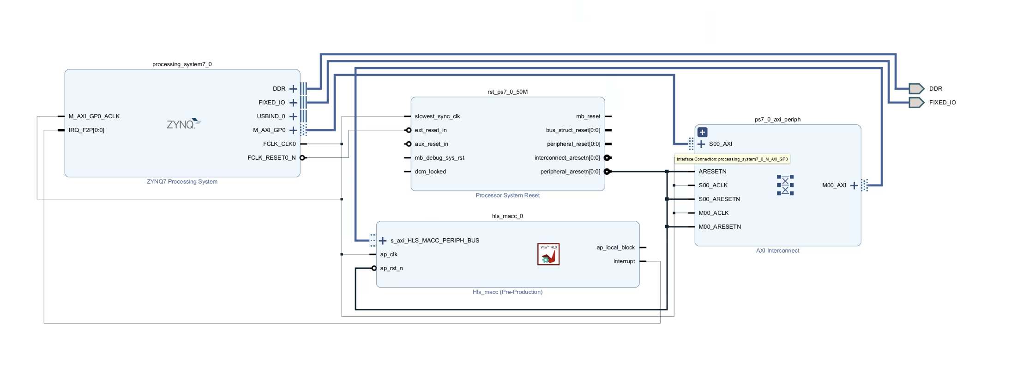
Block Design
Lab1 - MAC

Slide 11
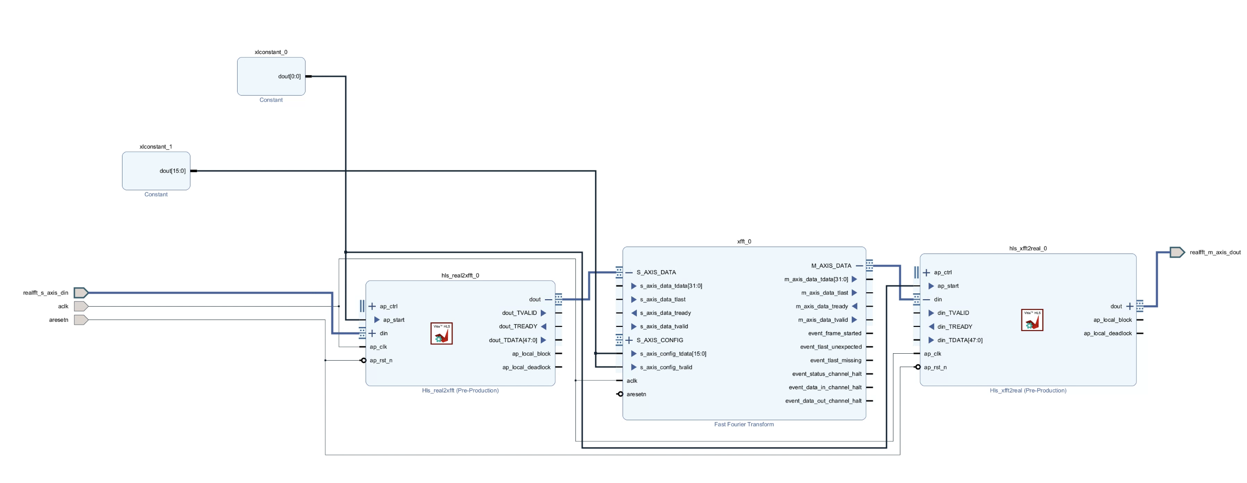
BLOCK DESIGN
Lab2 - Real FFT

Slide 12
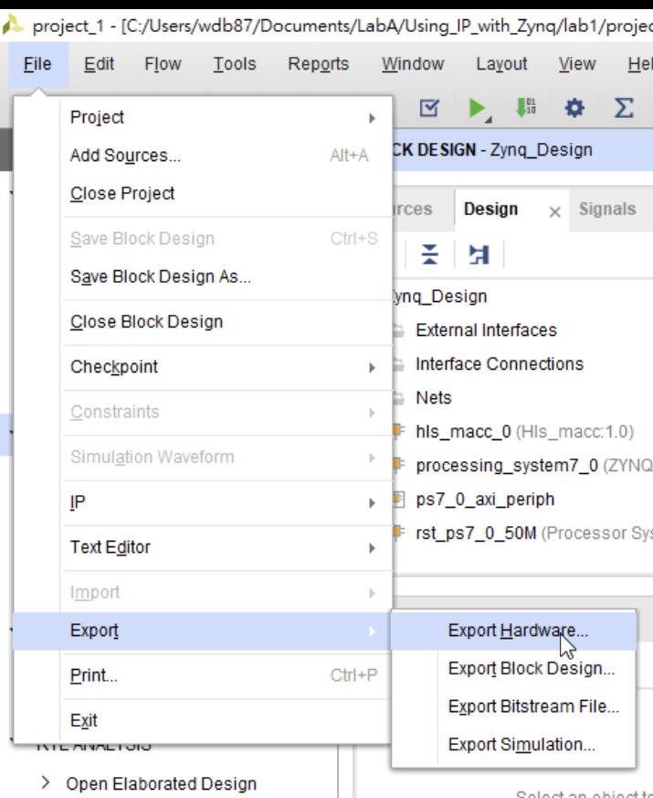
EXPORT HARDWARE (INCLUDE bitstream)

Slide 13
Contents
What you will learn
Vitis HLS IP Design
Design Code
Build Block Design through Vivado (Lab1,2)
ARM C code
Lab1 – MAC with AXI4-Lite
Lab2 – FFT with AXI4-Stream
Program FPGA and build C program through Vitis IDE

Slide 14
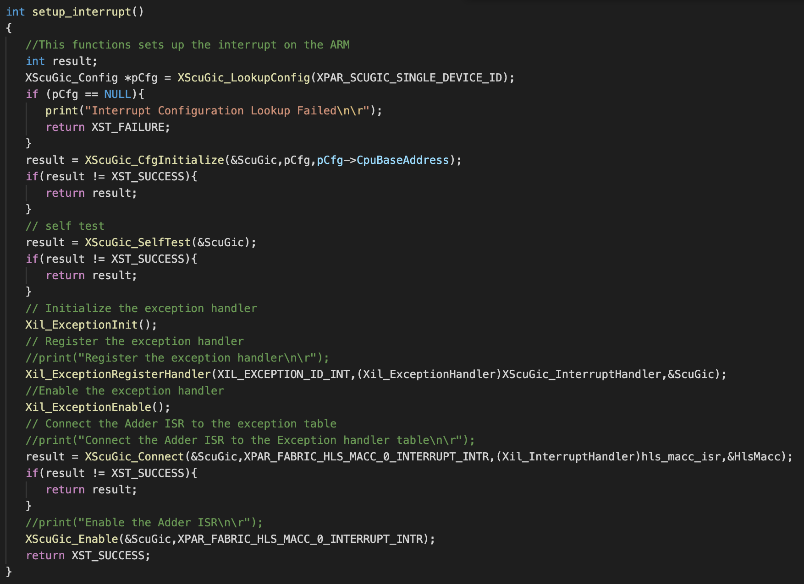
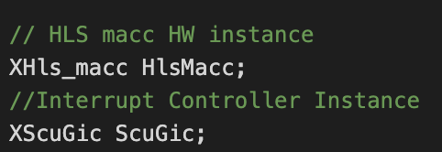
interruption Setup

Slide 15
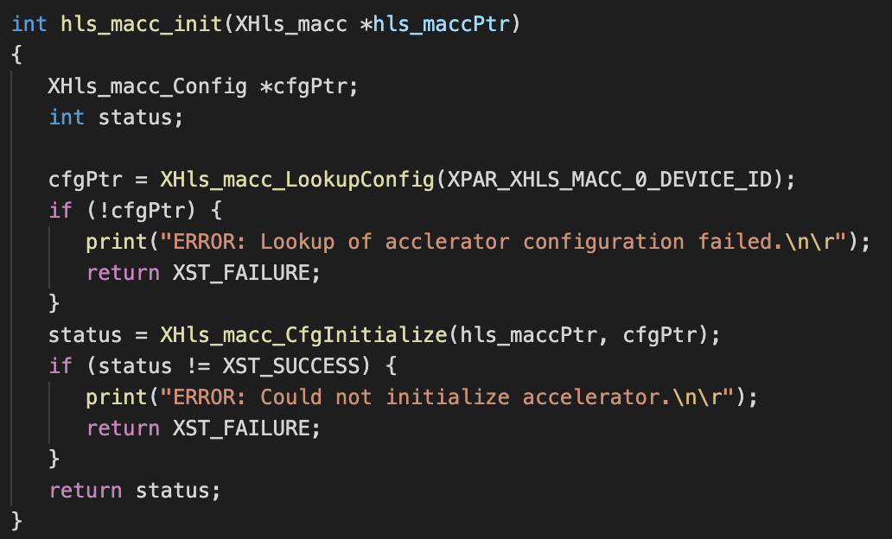
HLS BLOCK INITIALIZATION

Slide 16
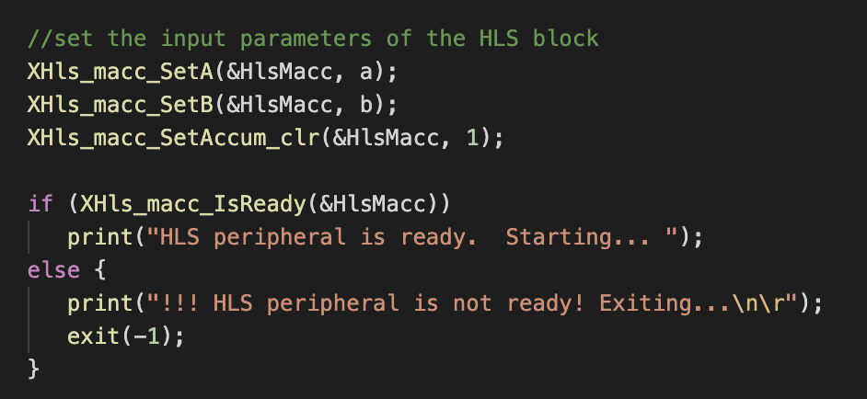
SET INPUT

Slide 17
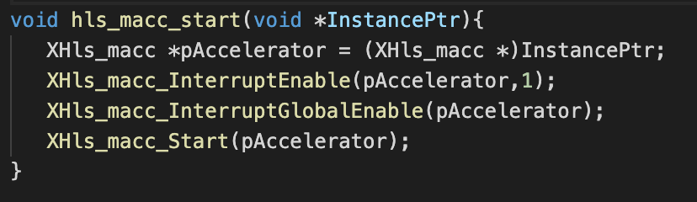
HLS BLOCK START (WITH INTERRUPTION)

Slide 18
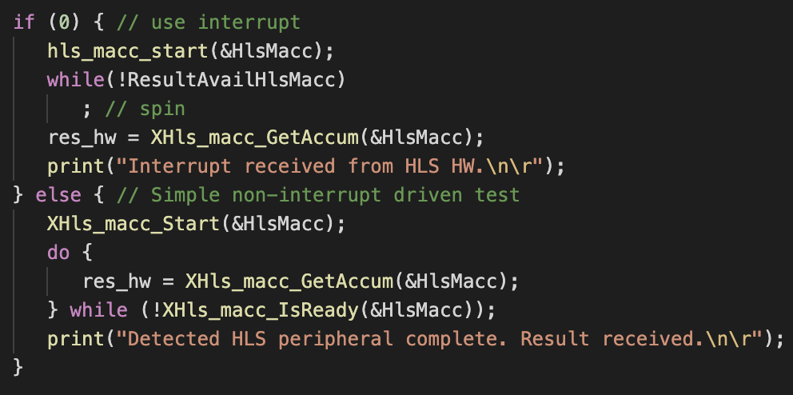
FETCH OUTPUT RESULT

Slide 19
Contents
What you will learn
Vitis HLS IP Design
Design Code
Build Block Design through Vivado (Lab1,2)
ARM C code
Lab1 – MAC with AXI4-Lite
Lab2 – FFT with AXI4-Stream
Program FPGA and build C program through Vitis IDE

Slide 20
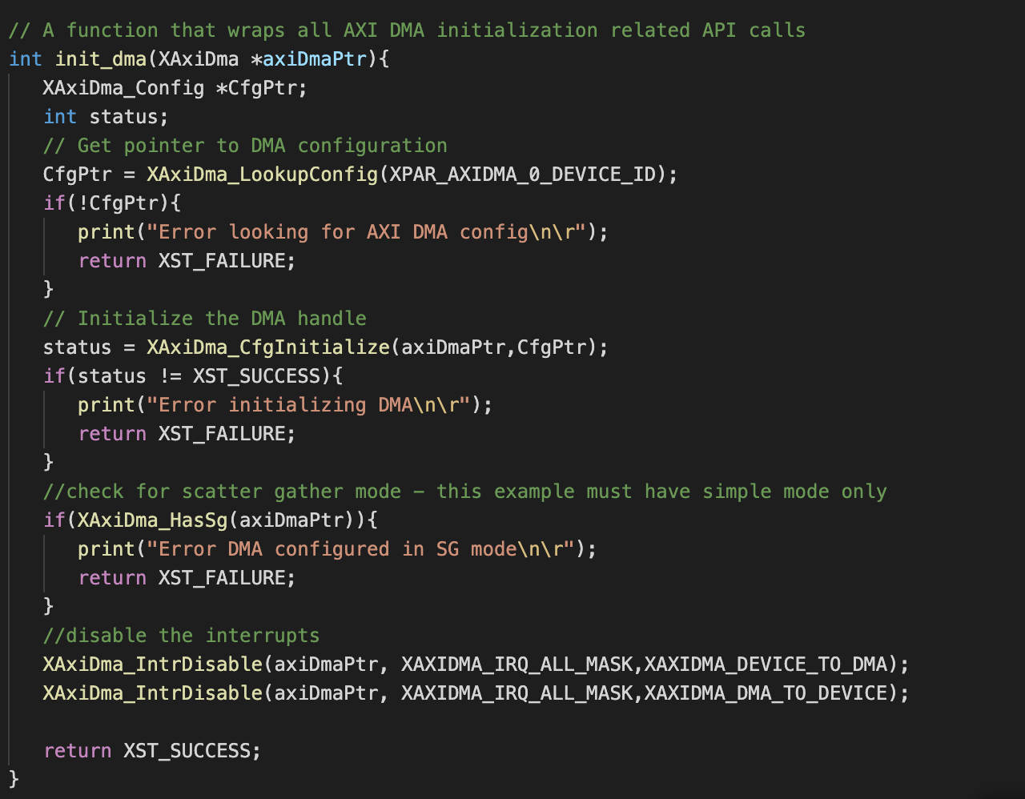
DMA INITIALIZATION

Slide 21
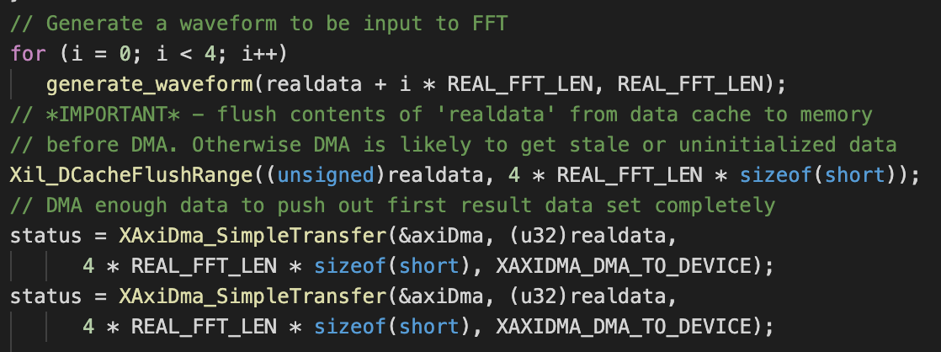
SEND DATA

Slide 22
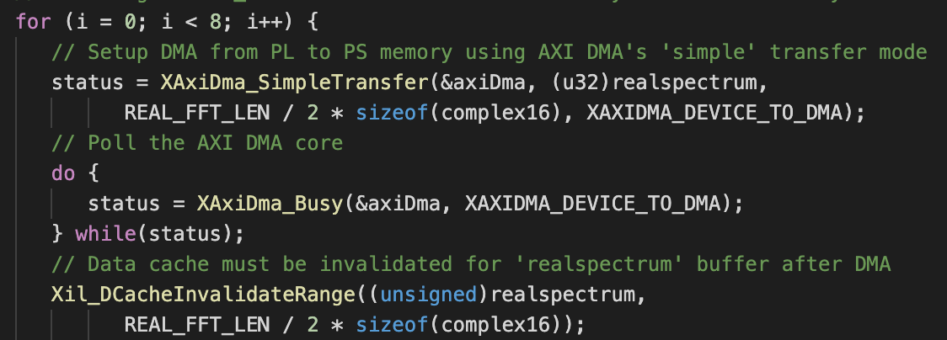
FETCH DATA

Slide 23
Contents
What you will learn
Vitis HLS IP Design
Design Code
Build Block Design through Vivado (Lab1,2)
ARM C code
Lab1 – MAC with AXI4-Lite
Lab2 – FFT with AXI4-Stream
Program FPGA and build C program through Vitis IDE

Slide 24
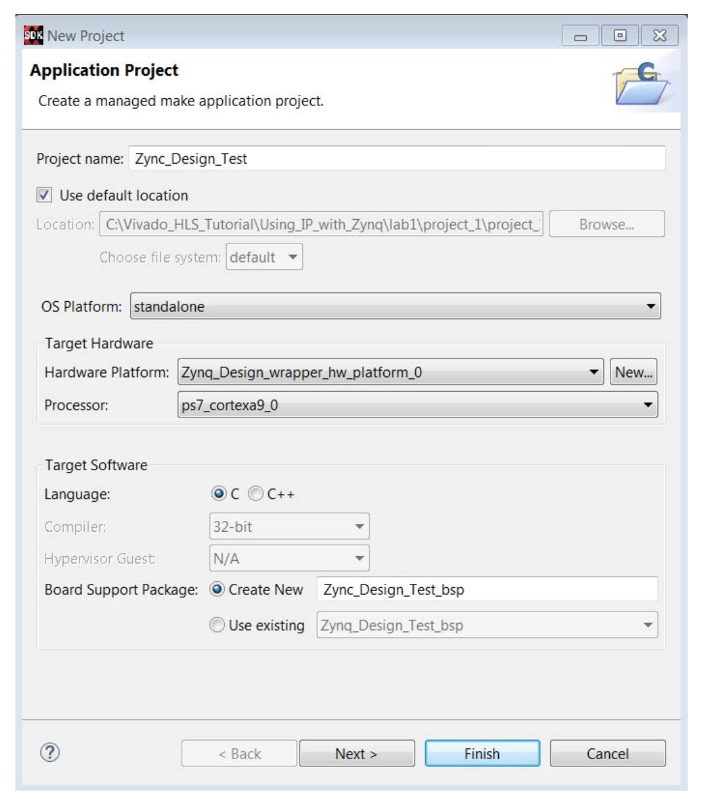
Application Project setting

Slide 25
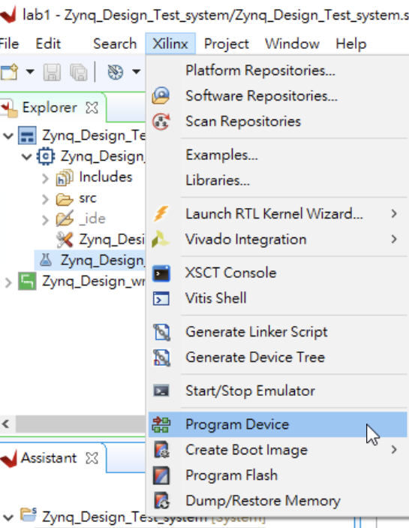
PROGRAM DEVICE

Slide 26
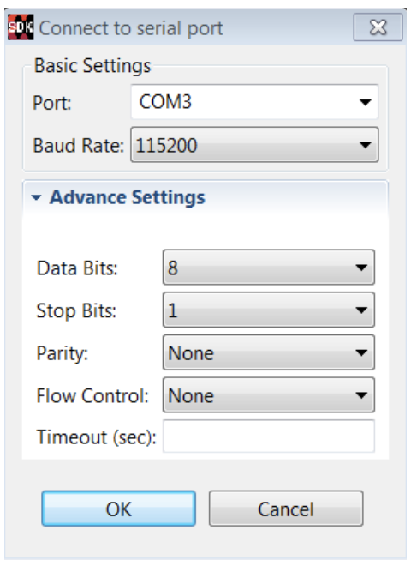
CONNECT to the TERMINAL

Slide 27
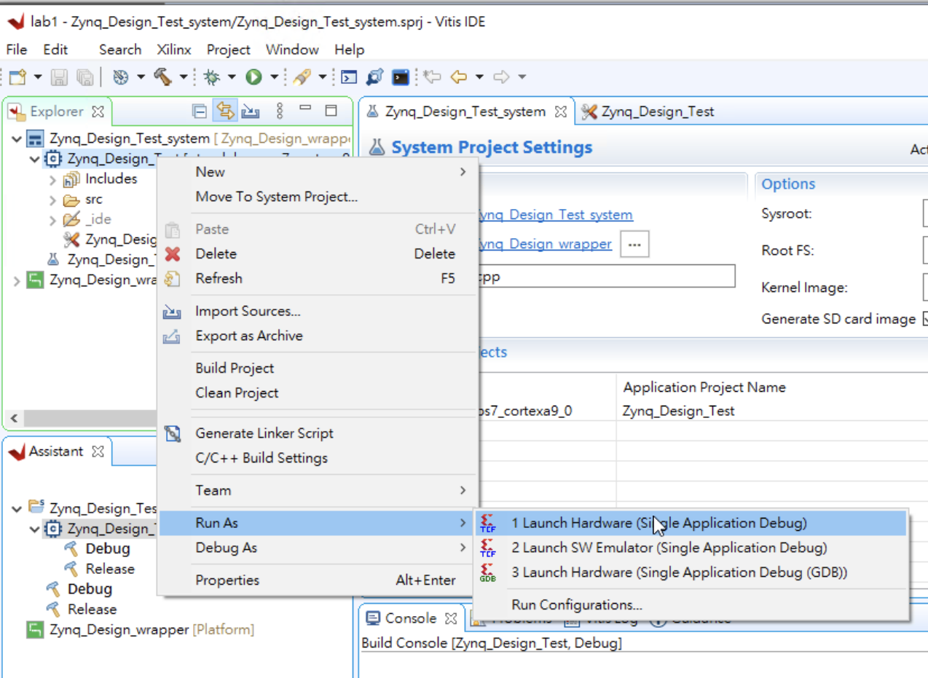
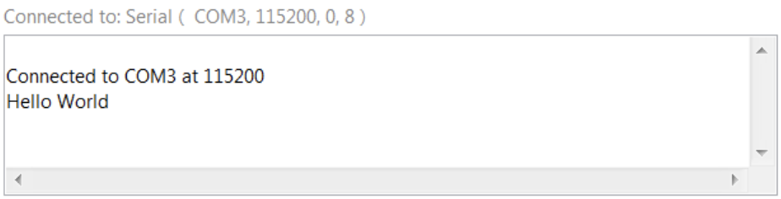
TEST “HELLO WORLD”

Slide 28
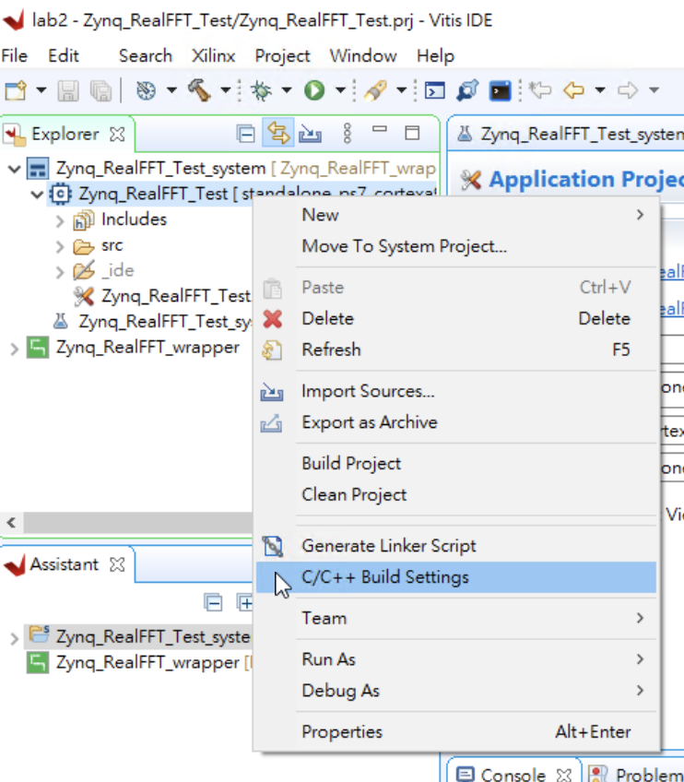
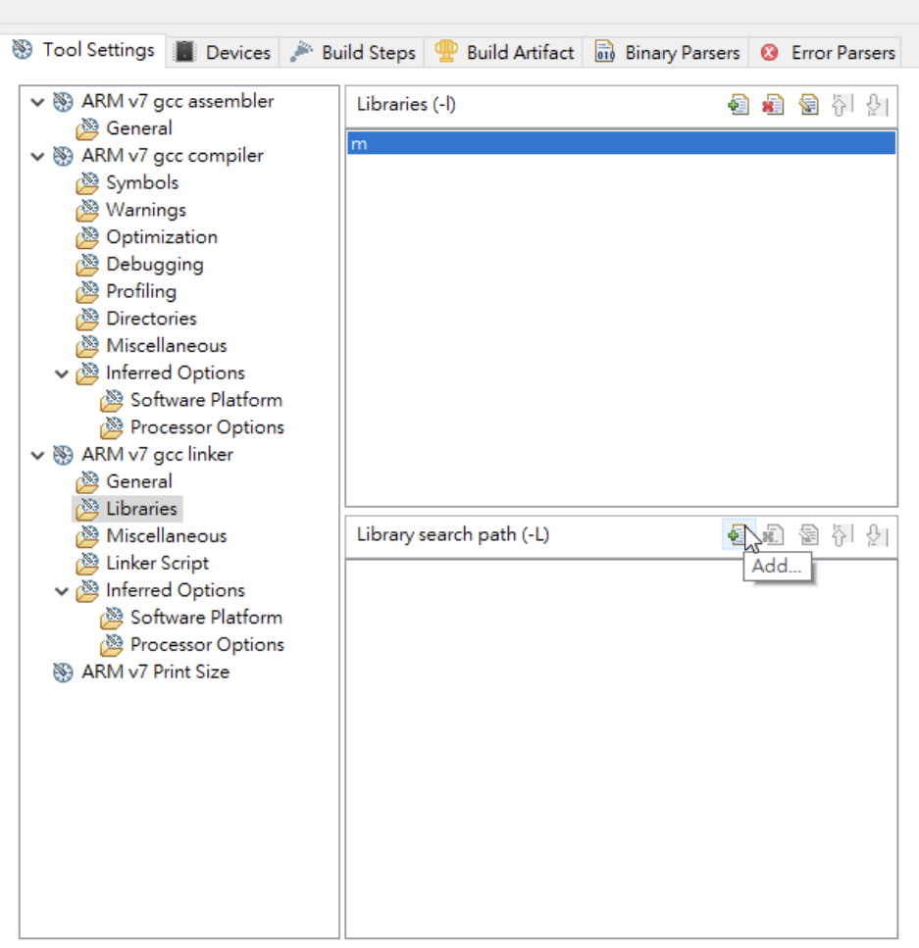
EDIT C/C++ BUILD SETTINGS (Lab2)

Slide 29
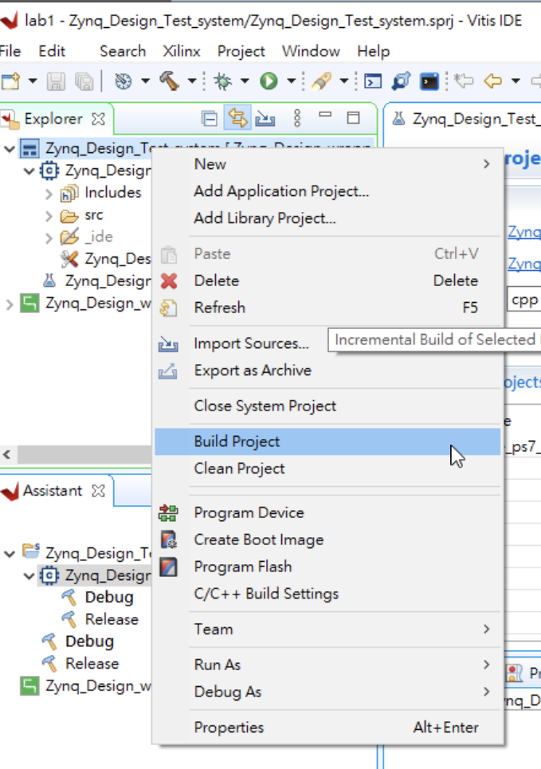
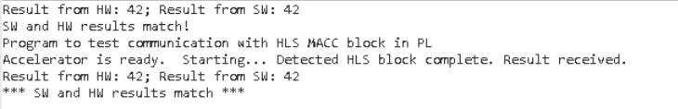
Build Project and Test it

Slide 30
Thank YOU
310551050 陳聖文

